Slide 1


Startup Clustering
Kamis 1 Oktober 2020
Muhamad Ariyanda Putra – Purwadhika Bekasi: Data Science After Hours Job Connector

Slide 2

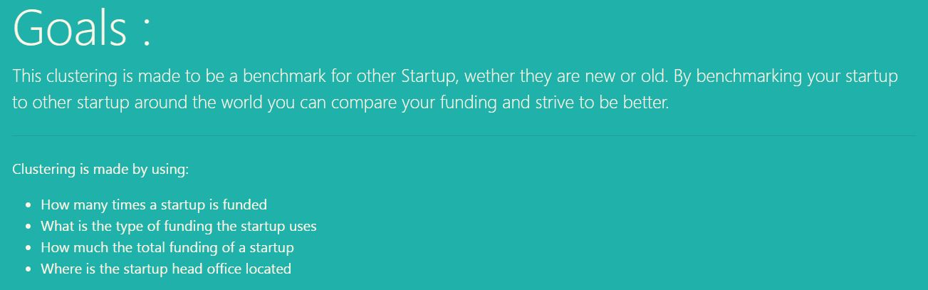
Kamis 1 Oktober 2020
test
Goals
test
test
Muhamad Ariyanda Putra – Purwadhika Bekasi: Data Science After Hours Job Connector

Slide 3
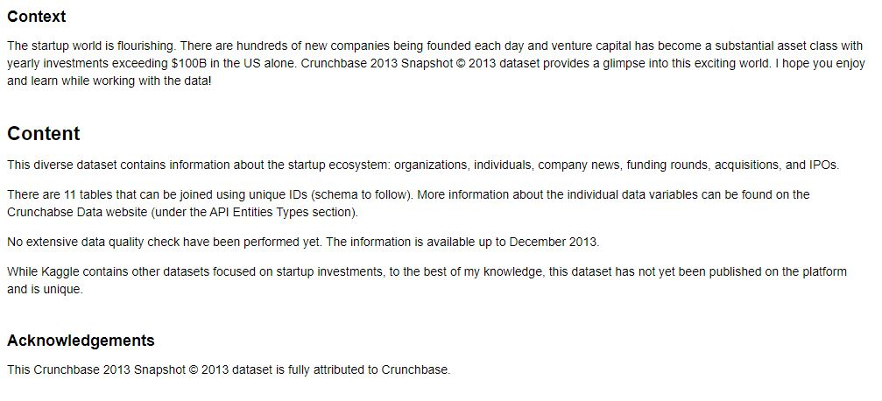
Kamis 1 Oktober 2020
test
Datasets
test
test
Muhamad Ariyanda Putra – Purwadhika Bekasi: Data Science After Hours Job Connector

Slide 4
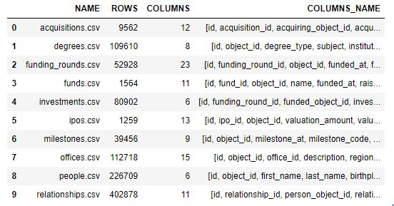
Kamis 1 Oktober 2020
test
Raw Data
test
test
Muhamad Ariyanda Putra – Purwadhika Bekasi: Data Science After Hours Job Connector

Slide 5
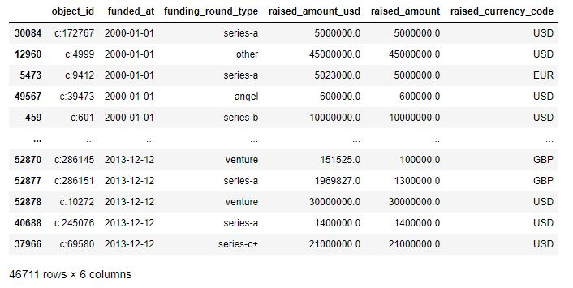
Kamis 1 Oktober 2020
test
Funding Rounds
Object_id or Startup can recur more than once because funding can be done multiple time in a series of runway as we can see in the funding_round_type
test
test
Muhamad Ariyanda Putra – Purwadhika Bekasi: Data Science After Hours Job Connector

Slide 6
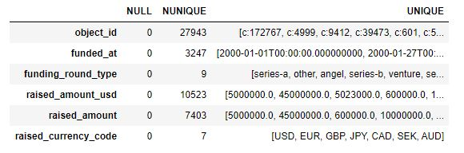
Kamis 1 Oktober 2020
test
Funding Rounds
Sorted by funded_at, remove rows with zero value in raised_amount or raise_amount_usd columns
test
test
Muhamad Ariyanda Putra – Purwadhika Bekasi: Data Science After Hours Job Connector

Slide 7
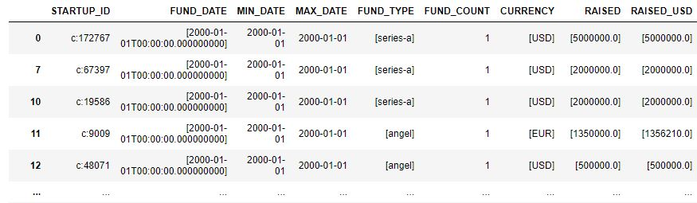
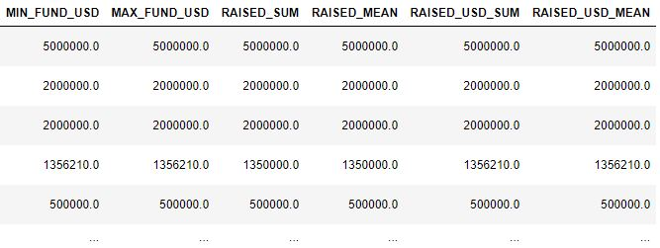
Kamis 1 Oktober 2020
test
Funding Rounds
test
Grouped by Startup_id and every occurrence of fund_type, currency, raised, raised_usd is collected in a list.
Drop row with outlier using IQR to determine the outlier
test
Muhamad Ariyanda Putra – Purwadhika Bekasi: Data Science After Hours Job Connector

Slide 8
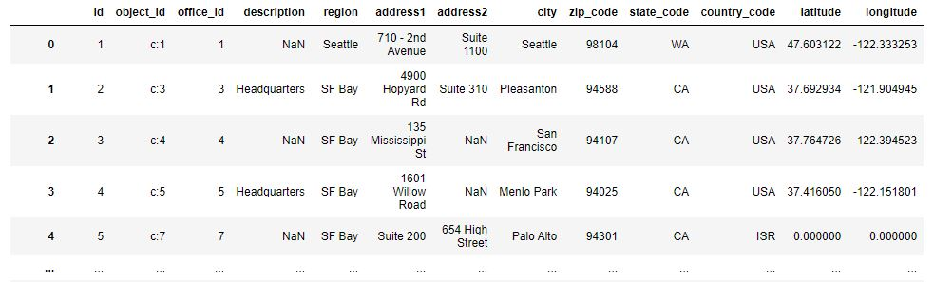
Kamis 1 Oktober 2020
test
Offices
test
test
Mergin offices columns: Latitude, Longitude, and Country code by Startup_id
And then labeling the country to the appropriate label using its unique and an array of 123 number starting from 0 to 122
Muhamad Ariyanda Putra – Purwadhika Bekasi: Data Science After Hours Job Connector

Slide 9
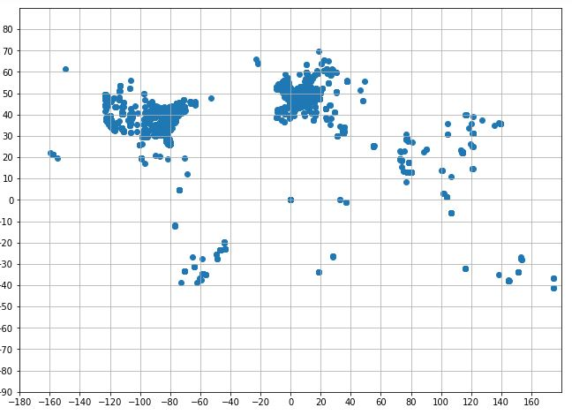
Kamis 1 Oktober 2020
test
Offices Scatterplot
test
test
Muhamad Ariyanda Putra – Purwadhika Bekasi: Data Science After Hours Job Connector

Slide 10
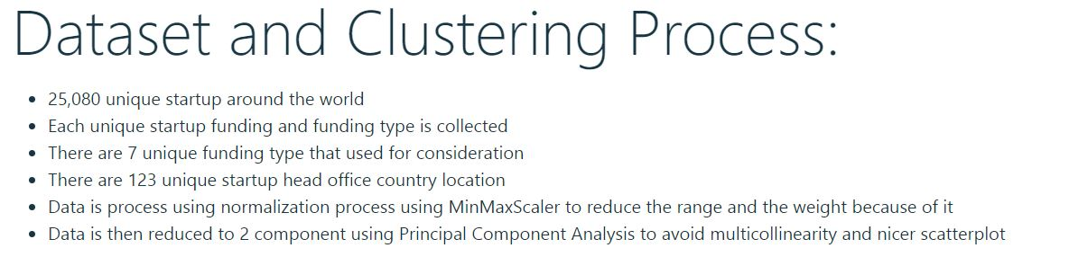
Kamis 1 Oktober 2020
test
Data Process
test
test
Muhamad Ariyanda Putra – Purwadhika Bekasi: Data Science After Hours Job Connector

Slide 11
Kamis 1 Oktober 2020
test
Clustering Model Used
Normalization
Normalized the numerical data using MinMaxScaler to prevent range to put on more weight on some variable.
Standardization is considered but cannot reduce the range better than normalization
Singular Value Decomposition
Reduced columns into 2 (two) component to avoid multicollinearity and nicer scatterplot
Clustering
Clustering is done using Kmeans
Checking the elbow, standard deviation of each number of cluster, and its improvement over the previous number of cluster used.
Scatterplot is used to see the clustering has good outcome or not
test
test
Muhamad Ariyanda Putra – Purwadhika Bekasi: Data Science After Hours Job Connector

Slide 12
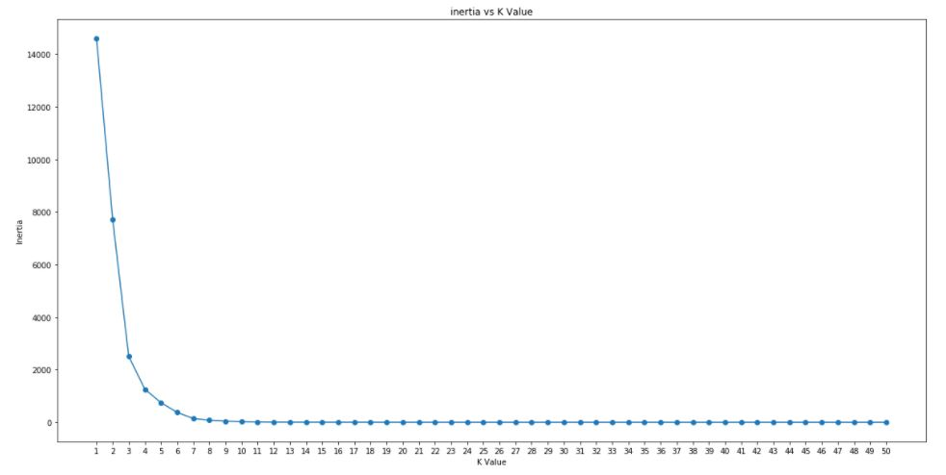
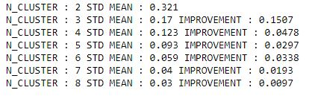
Kamis 1 Oktober 2020
test
Kmeans
test
test
Muhamad Ariyanda Putra – Purwadhika Bekasi: Data Science After Hours Job Connector

Slide 13
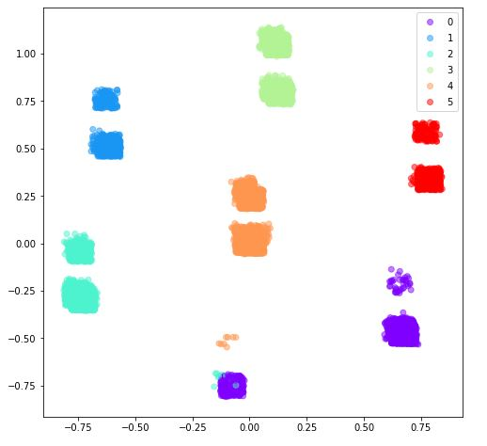
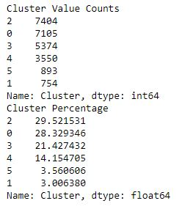
Kamis 1 Oktober 2020
test
Kmeans 6 Cluster
test
test
Muhamad Ariyanda Putra – Purwadhika Bekasi: Data Science After Hours Job Connector

Slide 14
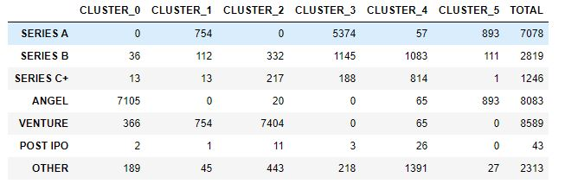
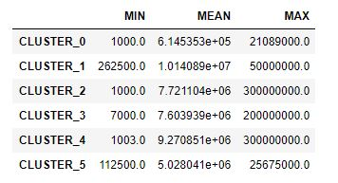
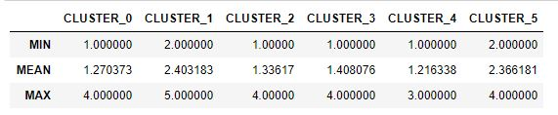
Kamis 1 Oktober 2020
test
Kmeans 6 Cluster
test
test
Based on these Cluster specific characteristic we try to categorized and named each cluster
Muhamad Ariyanda Putra – Purwadhika Bekasi: Data Science After Hours Job Connector

Slide 15
Kamis 1 Oktober 2020
test
Cluster Description
Cluster 0
- Took several funding mostly on Angel and some venture funding
- Second lowest fund count
- The lowest in term of average and maximum fund
Named : Angel Startup
Cluster 3
- Majority took Series A and Series B
- Above average fund count
- Below average in average total fund
Named : Early to Mid Startup
test
Cluster 1
- Mostly took series A and Venture funding
- A minimum of 2 times funding and the highest average fund count
- The highest in term of minimum funding and average funding
Named : Big Startup
Cluster 4
- Took funding mostly on Series B, Series C, or other funding
- Has the lowest average of fund count
- Has the second highest average total fund
Named : Late Fund Startup
test
Cluster 2
- Mostly took funding in form of Venture funding
- Below average fund count
- Above average in term of average total fund and has the highest maximum total fund
Named : Venture Startup
Cluster 5
- Took funding mostly on Series A or Angel fund
- 2nd highest fund count
- 2nd lowest average total fund
Named : Small Startup
Muhamad Ariyanda Putra – Purwadhika Bekasi: Data Science After Hours Job Connector

Slide 16
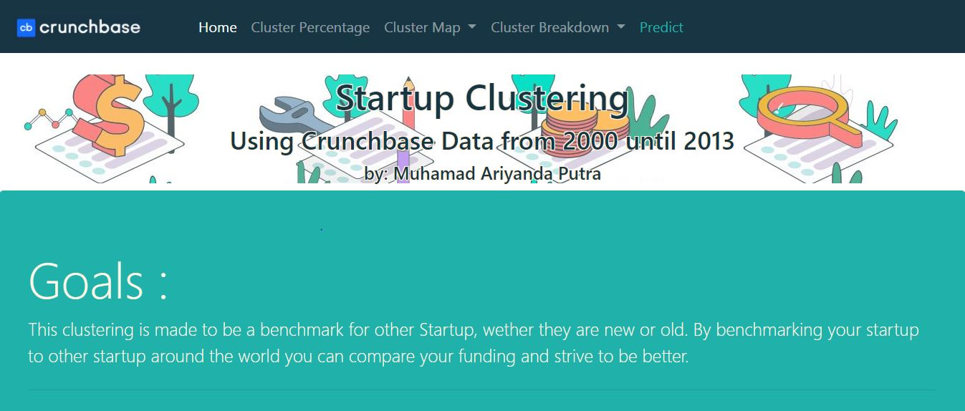
Kamis 1 Oktober 2020
test
Home
test
test
Muhamad Ariyanda Putra – Purwadhika Bekasi: Data Science After Hours Job Connector

Slide 17
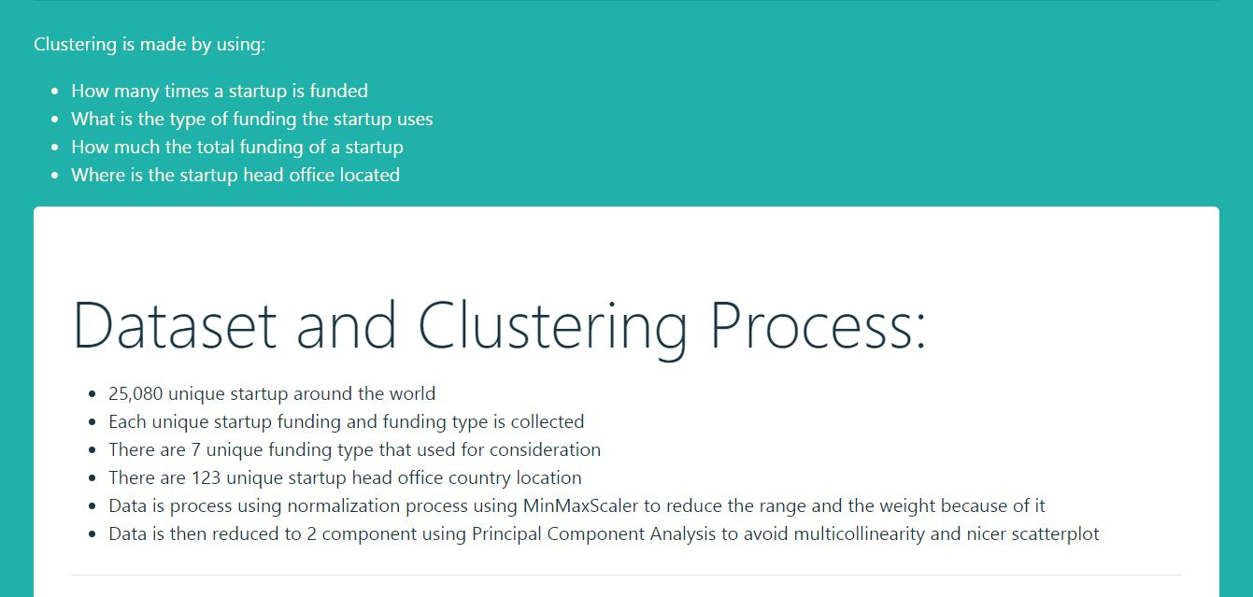
Kamis 1 Oktober 2020
test
Home
test
test
Muhamad Ariyanda Putra – Purwadhika Bekasi: Data Science After Hours Job Connector

Slide 18
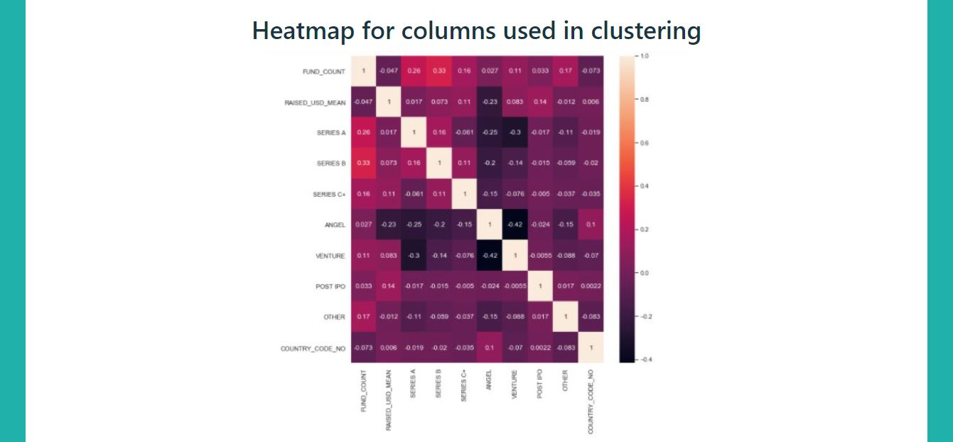
Kamis 1 Oktober 2020
test
Home
test
test
Muhamad Ariyanda Putra – Purwadhika Bekasi: Data Science After Hours Job Connector

Slide 19
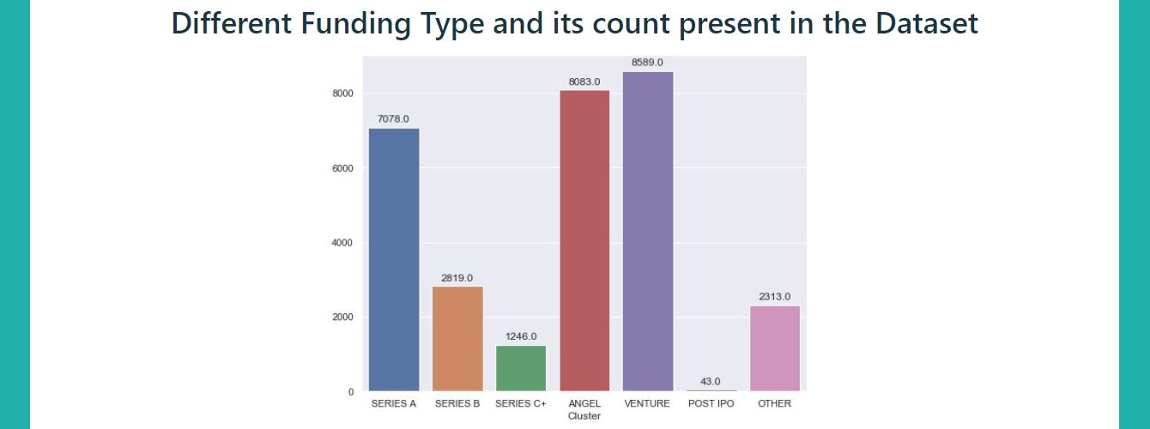
Kamis 1 Oktober 2020
test
Home
test
test
Muhamad Ariyanda Putra – Purwadhika Bekasi: Data Science After Hours Job Connector

Slide 20
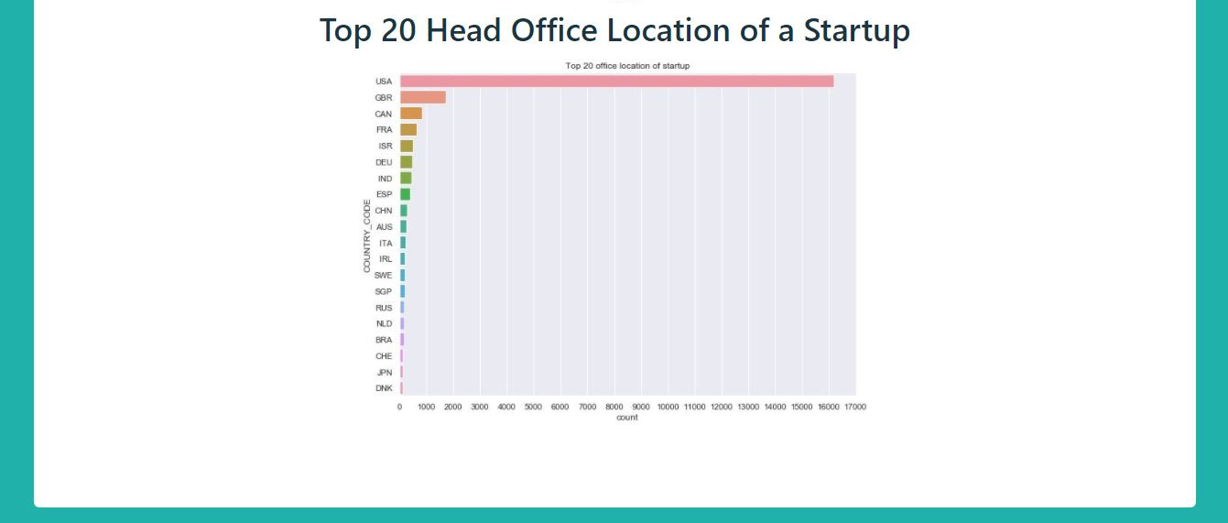
Kamis 1 Oktober 2020
test
Home
test
test
Muhamad Ariyanda Putra – Purwadhika Bekasi: Data Science After Hours Job Connector

Slide 21
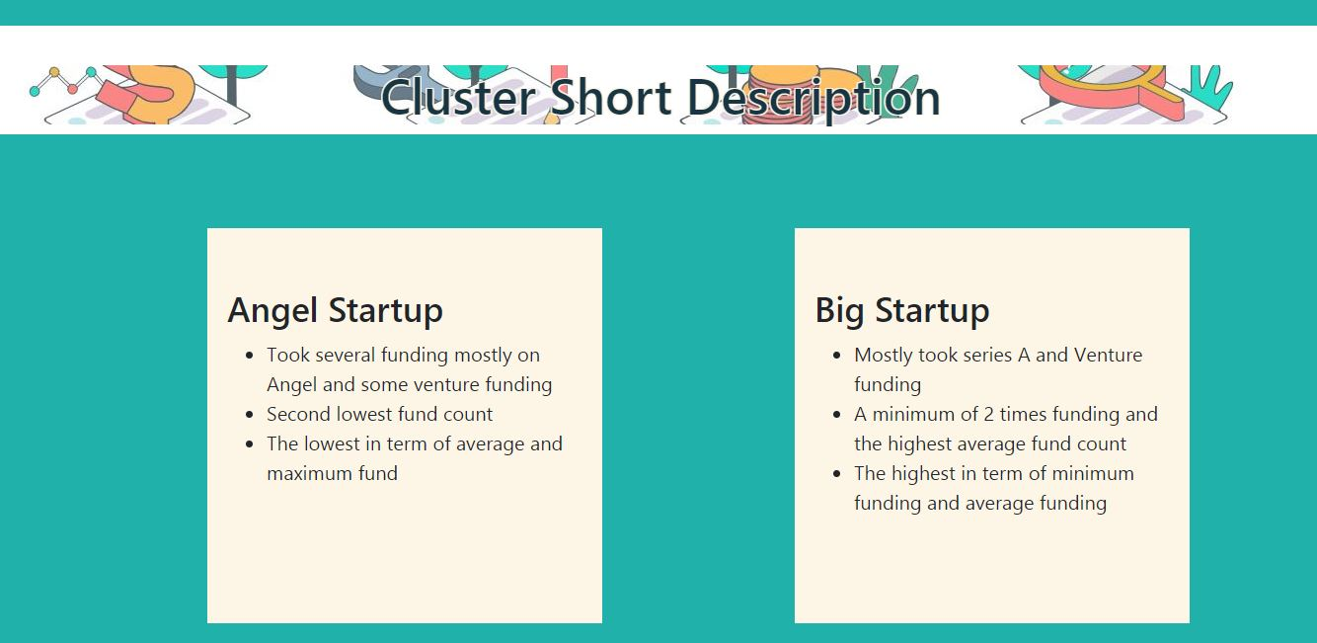
Kamis 1 Oktober 2020
test
Home
test
test
Muhamad Ariyanda Putra – Purwadhika Bekasi: Data Science After Hours Job Connector

Slide 22
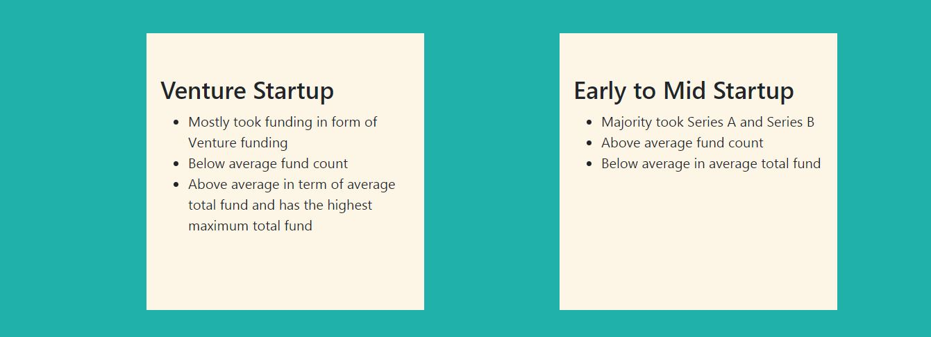
Kamis 1 Oktober 2020
test
Home
test
test
Muhamad Ariyanda Putra – Purwadhika Bekasi: Data Science After Hours Job Connector

Slide 23
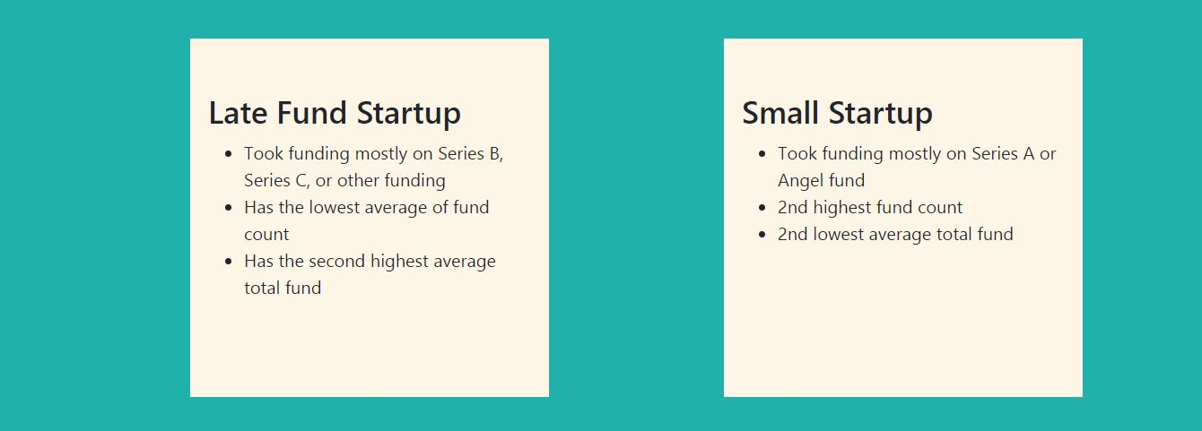
Kamis 1 Oktober 2020
test
Home
test
test
Muhamad Ariyanda Putra – Purwadhika Bekasi: Data Science After Hours Job Connector

Slide 24
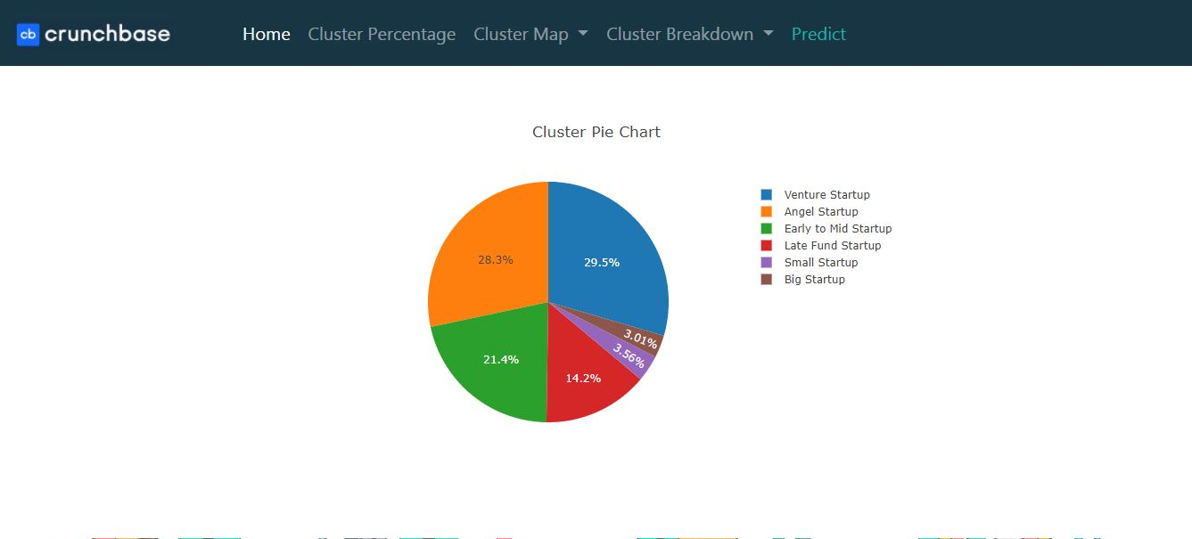
Kamis 1 Oktober 2020
test
Data Visualization
test
test
Muhamad Ariyanda Putra – Purwadhika Bekasi: Data Science After Hours Job Connector

Slide 25

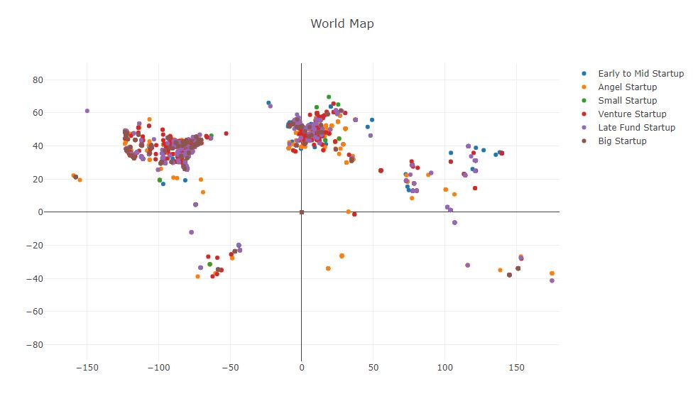
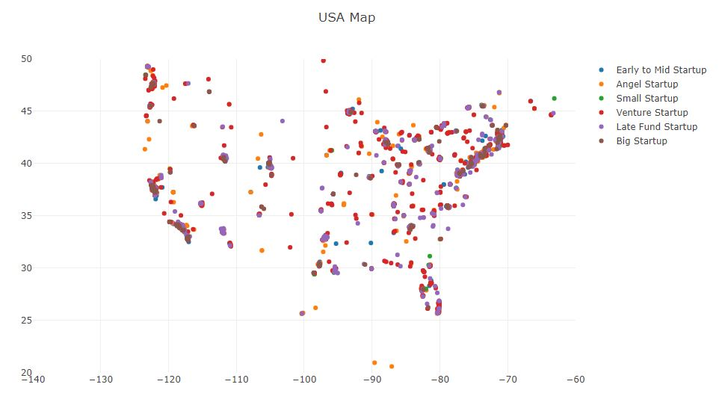
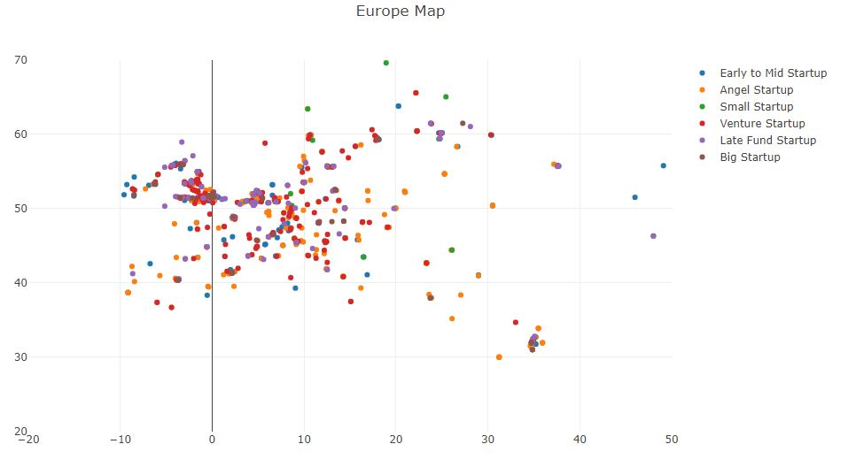
Kamis 1 Oktober 2020
test
Data Visualization
test
test
Muhamad Ariyanda Putra – Purwadhika Bekasi: Data Science After Hours Job Connector

Slide 26

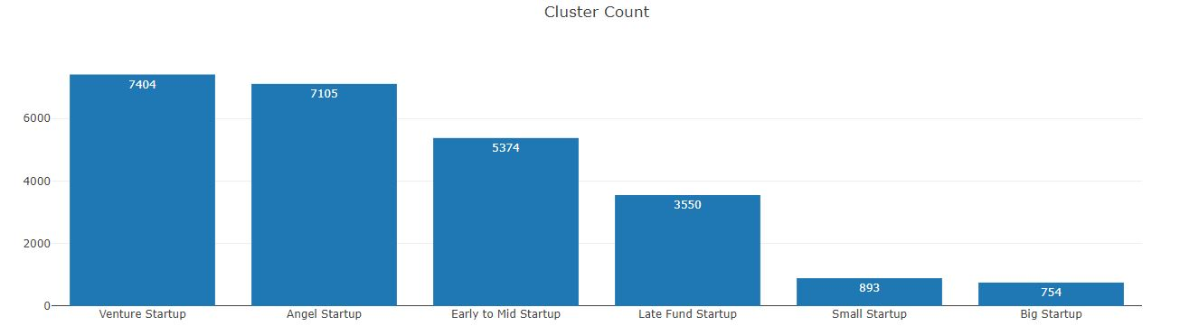
Kamis 1 Oktober 2020
test
Data Visualization
test
test
Muhamad Ariyanda Putra – Purwadhika Bekasi: Data Science After Hours Job Connector

Slide 27
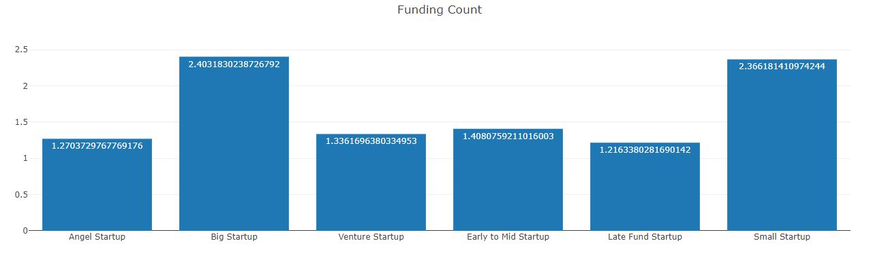
Kamis 1 Oktober 2020
test
Data Visualization
test
test
Muhamad Ariyanda Putra – Purwadhika Bekasi: Data Science After Hours Job Connector

Slide 28
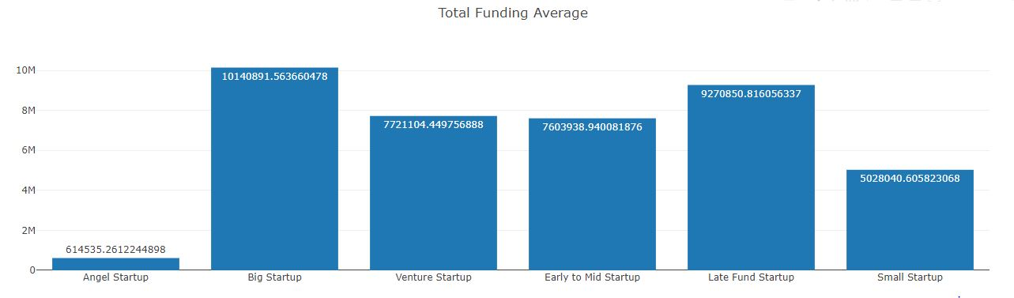
Kamis 1 Oktober 2020
test
Data Visualization
test
test
Muhamad Ariyanda Putra – Purwadhika Bekasi: Data Science After Hours Job Connector

Slide 29
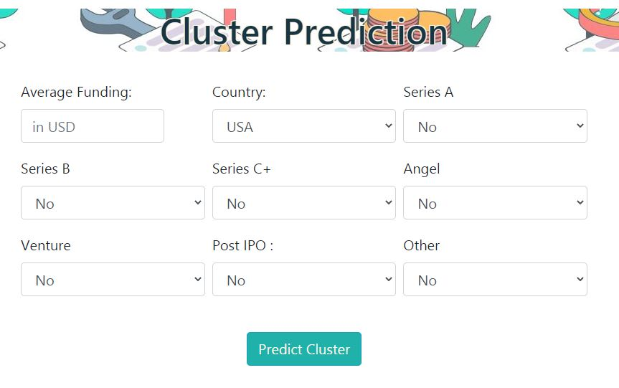
Kamis 1 Oktober 2020
test
Predict
test
test
Muhamad Ariyanda Putra – Purwadhika Bekasi: Data Science After Hours Job Connector

Slide 30
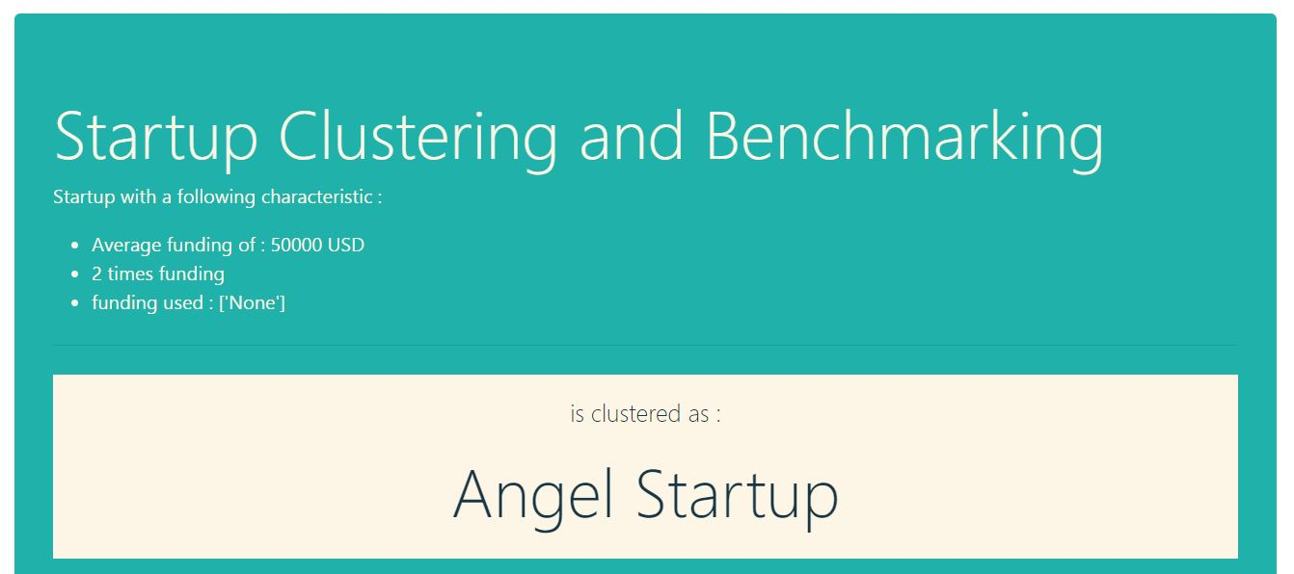
Kamis 1 Oktober 2020
test
Result
test
test
Muhamad Ariyanda Putra – Purwadhika Bekasi: Data Science After Hours Job Connector

Slide 31

Kamis 1 Oktober 2020
test
Result
test
test
Muhamad Ariyanda Putra – Purwadhika Bekasi: Data Science After Hours Job Connector

Slide 32
Startup Clustering
Kamis 1 Oktober 2020
Muhamad Ariyanda Putra – Purwadhika Bekasi: Data Science After Hours Job Connector

